Slide 1
Stack Data structure!

Slide 2
Instructor
Dr. Ab Rouf Khan
Assistant Professor
VIT Bhopal University

Slide 3
Entry level Questions
How do the Web Browsers store the history?
In which format does the e-commerce sites store the ‘whishlist’ of the customers?
Why are computers so successful?

Slide 4
Outline [Module 3 (Part 2)]
Stack and Queue
Introduction
Implementation (static and dynamic)
Applications
Circular Queues
Applications

Slide 5
Outline (Stack!)
Stack
Basic principles
Operations of stack
Stack using Array (Static Implementation)
Stack using Linked List (Dynamic Implementation)
Applications of stack
Depth first search / backtracking
Evaluating postfix expressions
Converting infix to postfix
Function calls (runtime stack)
Recursion

Slide 6
Last IN, First OUT
In
Out
C
B
A
B
C
Also called a
STACK

Slide 7

The Stack Data structure
Stack: A collection based on the principle of adding elements and retrieving them in the opposite order.
Last-In, First-Out ("LIFO")
Elements are stored in order of insertion.
We do not think of them as having indexes.
Client can only add/remove/examine the last element added (the "top").
Basic stack operations:
push: Add an element to the top.
pop: Remove the top element.
peek: Examine the top element.
push
pop, peek
top | 3
 | 2
bottom | 1
stack
Notes:
analogy: trays of food at the sizzler

Slide 8
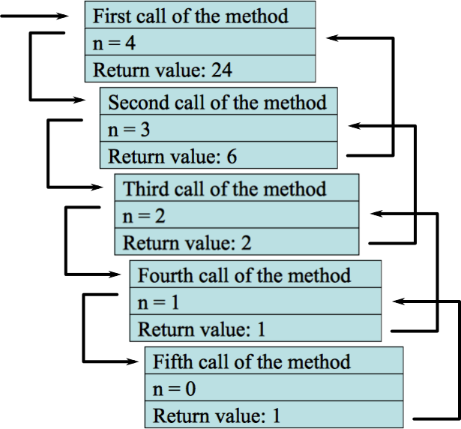
Stacks in Computer Science
Programming languages and compilers:
method calls are placed onto a stack
call=push
return=pop
compilers use stacks to evaluate expressions
Matching up related pairs of things:
find out whether a string is a palindrome
examine a file to see if its braces { } match
convert "infix" expressions to pre/postfix
Sophisticated algorithms:
searching through a maze with "backtracking"
many programs use an "undo stack" of previous operations

Slide 9

Basic Idea
A stack is an Abstract Data Type (ADT), commonly used in most programming languages. It is named stack as it behaves like a real-world stack, for example –
a deck of cards
or a pile of plates, etc.

Slide 10
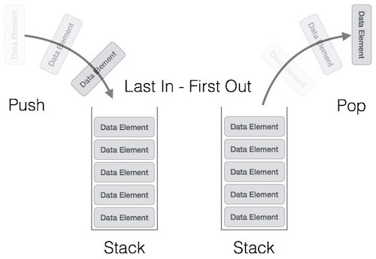
Stack Representation
Can be implemented by means of Array, Structure, Pointers and Linked List.
Stack can either be a fixed size or dynamic.

Slide 11
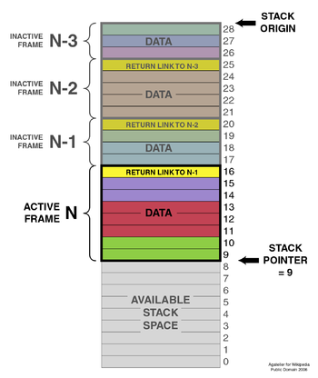
Basic Programming Architecture
Stacks retain Information about where to return
Stacks can be used (implicitly) to implement a technique called recursion

Slide 12
What is Stack good for?
Page-visited history in a Web browser
Undo sequence in a text editor
Saving local variables when one function calls another, and this one calls another

Slide 13
Basic Stack Operations
push()
STACK
pop()
create()
isempty()
isfull()

Slide 14
Basic Stack Operations
void push (stack *s, int element);
/* Insert an element in the stack */
int pop (stack *s);
/* Remove and return the top element */
void create (stack *s);
/* Create a new stack */
int isempty (stack *s);
/* Check if stack is empty */
int isfull (stack *s);
/* Check if stack is full */
Assumption: stack contains integer elements!

Slide 15
Stack Model – LIFO
Empty stack S
S.empty() is true
S.top() not defined
S.size() == 0
food chain stack

Slide 16
Stack Model – LIFO
S.push(“mosquito”)
S.empty() is false
S.top() == “mosquito”
S.size() == 1
mosquito
food chain stack

Slide 17
Stack Model – LIFO
S.push(“fish”)
S.empty() is false
S.top() == “fish”
S.size() == 2
fish
mosquito
food chain stack

Slide 18
Stack Model – LIFO
S.push(“raccoon”)
S.empty() is false
S.top() == “raccoon”
S.size() == 3
raccoon
fish
mosquito
food chain stack

Slide 19
Stack Model – LIFO
S.pop()
S.empty() is false
S.top() == “fish”
S.size() == 2
fish
mosquito
food chain stack

Slide 20
Array implementation of stacks
To implement a stack, items are inserted and removed at the same end (called the top)
Efficient array implementation requires that the top of the stack be towards the center of the array, not fixed at one end
To use an array to implement a stack, you need both the array itself and an integer
The integer tells you either:
Which location is currently the top of the stack, or
How many elements are in the stack

Slide 21
Pushing and popping
Pushing and popping
0 1 2 3 4 5 6 7 8 9
stk:
17
23
97
44
top = 3
or count = 4
If the bottom of the stack is at location 0, then an empty stack is represented by top = -1 or count = 0
To add (push) an element, either:
Increment top and store the element in stk[top], or
Store the element in stk[count] and increment count
To remove (pop) an element, either:
Get the element from stk[top] and decrement top, or
Decrement count and get the element in stk[count]

Slide 22
After Popping
0 1 2 3 4 5 6 7 8 9
stk:
17
23
97
44
top = 2
or count = 3
When you pop an element, do you just leave the “deleted” element sitting in the array?
The surprising answer is, “it depends”
If this is an array of primitives, or if you are programming in C or C++, then doing anything more is just a waste of time
If you are programming in Java, and the array contains objects, you should set the “deleted” array element to null
Why? To allow it to be garbage collected!

Slide 23
Push using Stack (Array Implementation)
top
PUSH
top

Slide 24
Pop using Stack (Array Implementation)
POP
top
top

Slide 25
Linked List implementation of stacks
Since all the action happens at the top of a stack, a singly-linked list (SLL) is a fine way to implement it
The header of the list points to the top of the stack
myStack:
44
97
23
17
Pushing is inserting an element at the front of the list
Popping is removing an element from the front of the list

Slide 26
Linked List implementation of stacks (Details)
With a linked-list representation, overflow will not happen (unless you exhaust memory, which is another kind of problem)
Underflow can happen, and should be handled the same way as for an array implementation
When a node is popped from a list, and the node references an object, the reference (the pointer in the node) does not need to be set to null
Unlike an array implementation, it really is removed--you can no longer get to it from the linked list
Hence, garbage collection can occur as appropriate

Slide 27
Push using Stack (LL Implementation)
PUSH OPERATION
top

Slide 28
Pop using Stack (LL Implementation)
POP OPERATION
top

Slide 29
Array and LL implementation of Stack – Basic Idea
In the array implementation, we would:
Declare an array of fixed size (which determines the maximum size of the stack).
Keep a variable which always points to the “top” of the stack.
Contains the array index of the “top” element.
In the linked list implementation, we would:
Maintain the stack as a linked list.
A pointer variable top points to the start of the list.
The first element of the linked list is considered as the stack top.

Slide 30
Error checking
Error Checking!
There are two stack errors that can occur:
Underflow: trying to pop (or peek at) an empty stack
Overflow: trying to push onto an already full stack
For underflow, you should throw an exception
If you don’t catch it yourself, Java will throw an ArrayIndexOutOfBounds exception
You could create your own, more informative exception
For overflow, you could do the same things
Or, you could check for the problem, and copy everything into a new, larger array

Slide 31
‘First things First’ – Stack Declaration
#define MAXSIZE 100
struct lifo
{
int st[MAXSIZE];
int top;
};
typedef struct lifo
stack;
stack s;
struct lifo
{
int value;
struct lifo *next;
};
typedef struct lifo
stack;
stack *top;
ARRAY
LINKED LIST

Slide 32
Stack Creation
void create (stack *s)
{
s->top = -1;
/* s->top points to
last element
pushed in;
initially -1 */
}
void create (stack **top)
{
*top = NULL;
/* top points to NULL,
indicating empty
stack */
}
ARRAY
LINKED LIST

Slide 33
Pushing an element into stack
void push (stack *s, int element)
{
if (s->top == (MAXSIZE-1))
{
printf (“\n Stack overflow”);
exit(-1);
}
else
{
s->top++;
s->st[s->top] = element;
}
}
void push (stack **top, int element)
{
stack *new;
new = (stack *)malloc (sizeof(stack));
if (new == NULL)
{
printf (“\n Stack is full”);
exit(-1);
}
new->value = element;
new->next = *top;
*top = new;
}
ARRAY
LINKED LIST

Slide 34
Popping an element from stack
int pop (stack *s)
{
if (s->top == -1)
{
printf (“\n Stack underflow”);
exit(-1);
}
else
{
return (s->st[s->top--]);
}
}
int pop (stack **top)
{
int t;
stack *p;
if (*top == NULL)
{
printf (“\n Stack is empty”);
exit(-1);
}
else
{
t = (*top)->value;
p = *top;
*top = (*top)->next;
free (p);
return t;
}
}
ARRAY
LINKED LIST

Slide 35
Checking for Stack Empty
int isempty (stack *s)
{
if (s->top == -1)
return 1;
else
return (0);
}
int isempty (stack *top)
{
if (top == NULL)
return (1);
else
return (0);
}
ARRAY
LINKED LIST

Slide 36
Checking for Stack Full
int isFull (stack *s)
{
if (s->top == (MAXSIZE-1))
return 1;
else
return (0);
}
int isFull (stack *top)
{
if (new == NULL)//if (!node)
return (1);
else
return (0);
}
ARRAY
LINKED LIST

Slide 37
Example: A Stack using an Array
#include <stdio.h>
#define MAXSIZE 100
struct lifo
{
int st[MAXSIZE];
int top;
};
typedef struct lifo stack;
main() {
stack A, B;
create(&A);
create(&B);
push(&A,10);
push(&A,20);
push(&A,30);
push(&B,100);
push(&B,5);
printf (“%d %d”, pop(&A), pop(&B));
push (&A, pop(&B));
if (isempty(&B))
printf (“\n B is empty”);
return;
}

Slide 38
Example: A Stack using Linked List
#include <stdio.h>
struct lifo
{
int value;
struct lifo *next;
};
typedef struct lifo stack;
main() {
stack *A, *B;
create(&A);
create(&B);
push(&A,10);
push(&A,20);
push(&A,30);
push(&B,100);
push(&B,5);
printf (“%d %d”, pop(&A), pop(&B));
push (&A, pop(&B));
if (isempty(B))
printf (“\n B is empty”);
return;
}

Slide 39
Applications of Stack (1)
Direct applications:
Page-visited history in a Web browser
Undo sequence in a text editor
Chain of method calls in the Java Virtual Machine
Validate XML
Indirect applications:
Auxiliary data structure for algorithms
Component of other data structures

Slide 40
Applications of Stack (2)
Depth first search / backtracking
Function calls (runtime stack)
Parenthesis Matching
Evaluating postfix expressions
Converting infix to postfix
Recursion

Slide 41
1. Depth First Search (Backtracking)
Problem
Discover a path from start to goal
Solution
Start from
Node start
Stop
If node is goal
Go deep
If there is an unvisited neighbor, go there
Backtrack
Retreat along the path to find an unvisited neighbor, if cannot go deeper
Outcome
If there is a path from start to goal, DFS finds one such path
start
1
2
3
4
5
6
7
8
9
10
11
12
goal

Slide 42
Depth First Search (Backtracking)
Stack
start
1
1
2
3
4
5
6
7
8
9
10
11
12
goal
Push

Slide 43
Depth First Search (Backtracking)
Stack
2
1
start
1
2
3
4
5
6
7
8
Push
9
10
11
12
Push
goal

Slide 44
Depth First Search (Backtracking)
Stack
5
2
1
start
1
2
3
4
5
6
7
8
Push
Push
9
10
11
12
Push
goal

Slide 45
Depth First Search (Backtracking)
Stack
6
5
2
1
start
1
2
3
4
Push
5
6
7
8
Push
Push
9
10
11
12
Push
goal

Slide 46
Depth First Search (Backtracking)
Stack
9
6
5
2
1
start
1
Push
2
3
4
Push
5
6
7
8
Push
Push
9
10
11
12
Push
goal

Slide 47
Depth First Search (Backtracking)
Stack
6
5
2
1
start
1
Pop
2
3
4
Push
5
6
7
8
Push
Push
9
10
11
12
Push
goal

Slide 48
Depth First Search (Backtracking)
Stack
5
2
1
start
1
2
3
4
Pop
5
6
7
8
Push
Push
9
10
11
12
Push
goal

Slide 49
Depth First Search (Backtracking)
Stack
2
1
start
1
2
3
4
5
6
7
8
Pop
Push
9
10
11
12
Push
goal

Slide 50
Depth First Search (Backtracking)
Stack
1
start
1
2
3
4
5
6
7
8
Pop
9
10
11
12
Push
goal

Slide 51
Depth First Search (Backtracking)
Stack
3
1
start
1
2
3
4
5
6
7
8
Push
9
10
11
12
Push
goal

Slide 52
Depth First Search (Backtracking)
Stack
7
3
1
start
1
2
3
4
5
6
7
8
Push
Push
9
10
11
12
Push
goal

Slide 53
Depth First Search (Backtracking)
Stack
10
7
3
1
start
1
2
3
4
Push
5
6
7
8
Push
Push
9
10
11
12
Push
goal

Slide 54
Depth First Search (Implementation (1))
DFS() {
stack<location> S;
// mark the start location as visited
S.push(start);
while (S is not empty) {
t = S.top();
if (t == goal) Success(S);
if (// t has unvisited neighbors) {
// choose an unvisited neighbor n
// mark n visited;
S.push(n);
} else {
BackTrack(S);}
}
Failure(S);
}

Slide 55
Depth First Search (Implementation (2))
BackTrack(S) {
while (!S.empty() && S.top() has no unvisited neighbors) {
S.pop();
}
}
Success(S) {
// print success
while (!S.empty()) {
output(S.top());
S.pop();
}
}

Slide 56
2. Runtime Stack
Runtime environment
Static
Executable code
Global variables
Stack
Push for each function call
Pop for each function return
Local variables
Heap
Dynamically allocated memories
new and delete
heap
stack
static
program memory

Slide 57
3. Parenthesis Matching
Each “(”, “{”, or “[” must be paired with a matching “)”, “}”, or “[”
correct: ( )(( )){([( )])}
correct: ((( )(( )){([( )])}
incorrect: )(( )){([( )])}
incorrect: ({[ ])}
incorrect: (

Slide 58
Parenthesis Matching Algorithm
Algorithm ParenMatch(X,n):
Input: An array X of n tokens, each of which is either a grouping symbol, a variable, an arithmetic operator, or a number
Output: true if and only if all the grouping symbols in X match
Let S be an empty stack
for i=0 to n-1 do
if X[i] is an opening grouping symbol then
S.push(X[i])
else if X[i] is a closing grouping symbol then
if S.isEmpty() then
return false {nothing to match with}
if S.pop() does not match the type of X[i] then
return false {wrong type}
if S.isEmpty() then
return true {every symbol matched}
else
return false {some symbols were never matched}

Slide 59
Infix and Postfix Notations
Infix: operators placed between operands:
A+B*C
Postfix: operands appear before their operators:-
ABC*+
There are no precedence rules to learn in postfix notation, and parentheses are never needed

Slide 60
4. Evaluation of Postfix Expressions
Easy to do with a stack
given a proper postfix expression:
get the next token
if it is an operand push it onto the stack
else if it is an operator
pop the stack for the right hand operand
pop the stack for the left hand operand (pop 1st time)
apply the operator to the two operands
push the result onto the stack (pop 2nd time)
when the expression has been exhausted the result is the top (and only element) of the stack

Slide 61
Postfix Expressions Calculator
Postfix expression: 6 3 + 2 * =
Evaluating the postfix expression: 6 3 + 2 * =

Slide 62
5. Infix to Postfix
Infix | Postfix
A + B | A B +
A + B * C | A B C * +
(A + B) * C | A B + C *
A + B * C + D | A B C * + D +
(A + B) * (C + D) | A B + C D + *
A * B + C * D | A B * C D * +
A + B * C → (A + (B * C)) → (A + (B C *) ) → A B C * +
A + B * C + D → ((A + (B * C)) + D ) → ((A + (B C*) )+ D) → ((A B C *+) + D) → A B C * + D +

Slide 63
Infix to postfix conversion
Use a stack for processing operators (push and pop operations).
Scan the sequence of operators and operands from left to right and perform one of the following:
output the operand,
push an operator of higher precedence,
pop an operator and output, till the stack top contains operator of a lower precedence and push the present operator.

Slide 64
Infix to postfix conversion Algorithm
Print operands as they arrive.
If the stack is empty or contains a left parenthesis on top, push the incoming operator onto the stack.
If the incoming symbol is a left parenthesis, push it on the stack.
If the incoming symbol is a right parenthesis, pop the stack and print the operators until you see a left parenthesis. Discard the pair of parentheses.
If the incoming symbol has higher precedence than the top of the stack, push it on the stack.
If the incoming symbol has equal precedence with the top of the stack, use association. If the association is left to right, pop and print the top of the stack and then push the incoming operator. If the association is right to left, push the incoming operator.
If the incoming symbol has lower precedence than the symbol on the top of the stack, pop the stack and print the top operator. Then test the incoming operator against the new top of stack.
At the end of the expression, pop and print all operators on the stack. (No parentheses should remain.)

Slide 65
Infix to Postfix Conversion
Requires operator precedence information
Operands:
Add to postfix expression.
Close parenthesis:
pop stack symbols until an open parenthesis appears.
Operators:
Pop all stack symbols until a symbol of lower precedence appears. Then push the operator.
End of input:
Pop all remaining stack symbols and add to the expression.

Slide 66
Infix to Postfix Conversion Rules
 | Current symbol | Operator Stack | Postfix string
1 | A |  | A
2 | * | * | A
3 | ( | * ( | A
4 | B | * ( | A B
5 | + | * ( + | A B
6 | C | * ( + | A B C
7 | * | * ( + * | A B C
8 | D | * ( + * | A B C D
9 | ) | * | A B C D * +
10 | + | + | A B C D * + *
11 | E | + | A B C D * + * E
12 |  |  | A B C D * + * E +
Expression:
A * (B + C * D) + E
becomes
A B C D * + * E +
Postfix notation is also called as Reverse Polish Notation (RPN)

Slide 67
Summary
Stack
Last In First Out (LIFO) data structure
Implemented as array or linked list
Arrays: limited number of elements
Linked lists: allow dynamic element addition
Stack use in compliers
Translate infix expressions into some form of postfix notation
Translate postfix expression into machine code
Standard Template Library (STL)
Provides a class to implement a stack in a program

Slide 68

Recap

Slide 69
Thank You

